Slide 1
Using Grammar to Improve Writing
by Sarah Tantillo, Ed.D., LLC

Slide 2
DO NOW: What is most challenging for you about teaching grammar and writing?

Slide 3
Why Grammar Matters, No Matter What You Teach…
Notes:
“If you think about sentences as containers for ideas, for many of our students, it seems like they are trying to carry soup, and all they know is carrots. Whether you teach English or not, it’s important to emphasize the importance of good sentence writing. Good writers write one good sentence after another. In History class, to make effective arguments and support them with relevant evidence and explanation, you need to write clear, coherent sentences.”

Slide 4
Notes:
Quick commercial interruption: This workshop is based on materials on my Website…

Slide 5
TLC Blog
Notes:
And my BLOG, which is FREE,

Slide 6
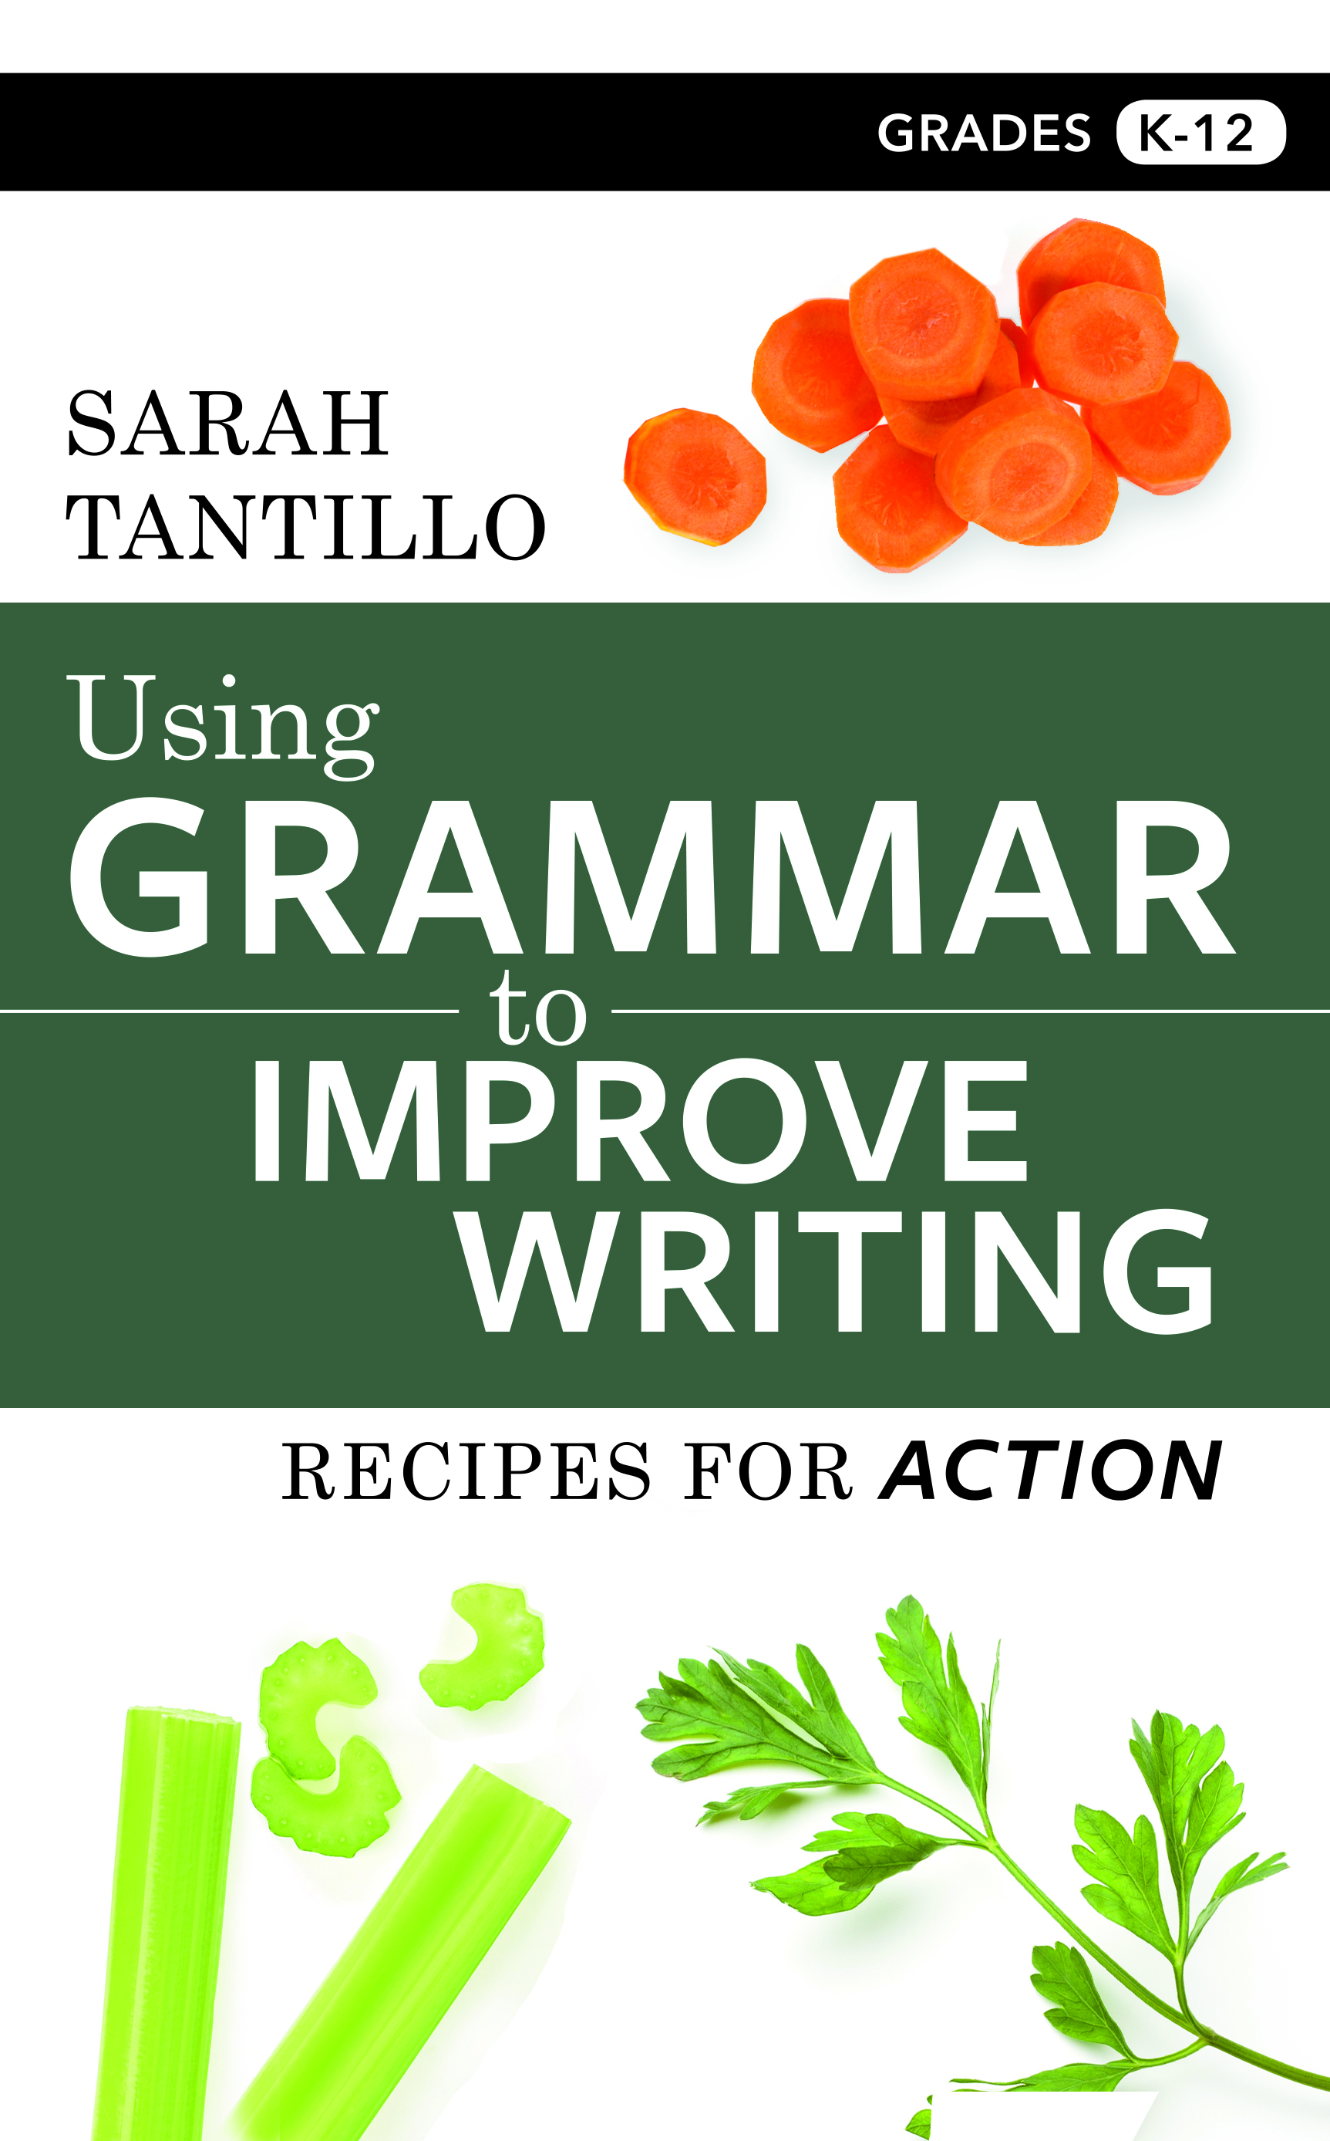
Notes:
…and in this book.

Slide 7
Notes:
You might also be interested in my other two literacy books…

Slide 9
AGENDA: 1. How we teach writing at GOLCS. 2. What to STOP doing 3. Seven principles for effective grammar/writing instruction 4. How to help students who are not on grade level 5. Other factors that affect how well we write 6. How to meet the Common Core Standards for Language and Writing SYSTEMATICALLY

Slide 10
How We Teach Writing at GOLCS: 1. Quickly SORT and ASSESS Exit Tickets (or recent writing) to determine potential writing/grammar needs. 2. Design a WRITING MINI-LESSON targeting those needs. Include at least one proficient exemplar and one not-yet-proficient example. 3. Students REVISE: A) independently, B) with Partner Feedback Protocol, or C) through Writing Conferences.
Notes:
We collect and analyze data. Then we plan. Then we implement the plan, and students have opportunities to revise and improve their writing.

Slide 11
What should we
doing?
Notes:
Before you start doing useful things, you have to stop doing things that don’t work.

Slide 12
making students
copy down
RULES or
DEFINITIONS
first.
Notes:
WHILE IT MIGHT SEEM EFFICIENT, it takes away the mystery, and the information goes in one ear and out the other. IT WON’T STICK BECAUSE IT’S NOT STICKY.

Slide 13
using
DAILY ORAL
LANGUAGE.
Notes:
Not an issue at GOLCS, but in case anyone thinks it’s a good idea, I’m leaving this slide in. Mark Pennington wrote a compelling blog post on 16 reasons why DOL does not work here: https://blog.penningtonpublishing.com/grammar_mechanics/why-daily-oral-language-d-o-l-doesnt-work/

Slide 14
DOL example:
“we where all exited because we jumped up and down.”
Notes:
Multiple RANDOM errors and The Because Problem.

Slide 15
Better:
“Running home, he tripped on his shoelaces.”
vs.
“He tripped on his shoelaces, running home.”
Notes:
There’s a TARGETED problem; students have to identify the problem and explain it. That can then lead to a strategic discussion about a PARTICULAR grammar point—in this case, how to fix MISPLACED MODIFIERS.

Slide 16
drilling.
Notes:
Again, IT MIGHT SEEM EFFICIENT, BUT IT’S NOT STICKY.

Slide 17
Drilling example:
“Circle every adverb.”
Compare this to:
“Write a sentence using an adverb and explain how it functions in the sentence.”
Notes:
Drilling IDENTIFIES but DOES NOT APPLY grammatical forms so there is NO TRANSFERENCE to actual student writing. In other words, it is GRAMMAR IN ISOLATION, which research shows does not work.

Slide 18
over-editing
student work!
Notes:
Here’s the GOOD NEWS! You can have hours of your life back!!!

Slide 19
Seven Principles
for Effective Grammar/ Writing Instruction

Slide 20
#1: Treat Students Like Detectives.
 | COLUMN A | COLUMN B
1) | I like John. | I like him.
2) | I saw Shana at the game. | I saw her at the game.
3) | I met Christine and Rochelle for dinner. | I met them for dinner.
4) | I like basketball. | I like it.
Notes:
Here’s a way to introduce PRONOUNS. “What is similar and different between Column A and Column B? What do you notice?”

Slide 21
#2: Explain Why This Lesson Matters. See TLC “RPM Objectives” page. See also “Scripting the Pitch” materials on pp. 19-20 in Using Grammar…
Notes:
TLC “RPM Objectives” page: https://www.literacycookbook.com/page.php?id=43

Slide 22
Rigorous, Purposeful, Measurable Objectives e.g., SWBAT explain how pronouns work in order to use them effectively in their writing.

Slide 23
#3: Ask, “What Do You Like About That Sentence?” →See Argument vs. Evidence “desk paragraph” lesson.
Notes:
The Argument vs. Evidence “desk paragraph” lesson can be found on the TLC “Argument vs. Evidence” page here: https://www.literacycookbook.com/page.php?id=159

Slide 24
It’s true. The inside of a typical fifth-grader’s desk is difficult to keep organized and clean. There is never enough room for all of the textbooks, workbooks, independent reading books, binders, and notebooks, much less the pens, pencils, and erasers. Plus, because students are normally not permitted to leave their seats during class, it is tempting to use the desk as a personal trash can. Crumpled paper, used tissues, bent paper clips, and loose pencil shavings need a place to go, and the desk makes a convenient hiding spot.
Notes:
In case you haven’t seen my “Argument vs. Evidence” video module, I will run through that mini-lesson now. If you’ve already seen this mini-lesson, you can fast-forward to the next principle.

Slide 25
#4: Give Faster Feedback. 1) Whole-class Mini-lesson 2) Writing Conferences 3) Partner Feedback Protocol

Slide 26
1) Whole-class Mini-lesson: INTRODUCING A GRAMMAR POINT: --Show proficient exemplar vs. equally proficient exemplar stated a different way (e.g., the pronouns example). Ask students what is different between the two examples. --Explain how the grammar point works and why it is important. --Give students more sentences to apply this point to. --Students write their own sentences/paragraphs using this skill.

Slide 27
1) Whole-class Mini-lesson: INTRODUCING A GRAMMAR POINT: PRACTICE: 1. Skim through Using Grammar… and find a grammar point you want to introduce. 2. Create a PPT slide to show students: It must include something that they NEED TO FIGURE OUT.

Slide 28
1) Whole-class Mini-lesson: REVISION BASED ON COMMON NEED: --Show proficient vs. not-yet-proficient examples. Ask students what is different and what we would have to DO DIFFERENTLY to make the weaker example strong. Ask them how they would solve this problem. If relevant, show them additional possible solutions. --Provide additional examples to improve and invite their input. --Get them to look at their own writing, focusing ONLY on this target skill.

Slide 29
1) Whole-class Mini-lesson: REVISION BASED ON COMMON NEED: PRACTICE: 1. Sort the given writing into proficient vs. not-yet-proficient examples. 2. Figure out the most high-leverage grammar/writing skill to teach. Look it up in Using Grammar… and make a plan.
Notes:
If you’re able to do this as a workshop with a team, look at student writing samples and practice together.

Slide 30
2) Writing Conferences: --Establish the focus. You are not “reading for everything.” --Groups of 3-4 bring their laptops up. --Start with praise, e.g., “I like what you are trying to do here.” --Ask questions: “Can you clarify? Can you elaborate? Can you explain?” --Do NOT judge/critique. --Others will “academically eavesdrop.” --Set a goal for the first student, then turn to the next one.

Slide 31
3) Partner Feedback Protocol: --ROLL-OUT IS KEY: Model with a student, then let the class practice. Then ask, “What was challenging about doing this?” Strong students often want to tell the others what to do. →Clarify: “Can you please clarify …?” →Elaborate: “Can you please say more about…?” →Praise: “I like the way you…?” --The writer makes marginal notes. It is not a negotiation. See the handout.
Notes:
The “Partner Feedback Protocol” can be found on the TLC “Using Grammar to Improve Writing” page here: https://www.literacycookbook.com/page.php?id=161

Slide 32
#5: Celebrate Success. →Use “Show Call”—esp. to praise excellent student work on Exit Tickets from the previous day.

Slide 33
#6: Provide Oral Support.
FORMAL | INFORMAL
I have two dogs. | I have two dog.
Taylor likes cats. | Taylor likes cat.
All the boys… | All the boy…

Slide 34
#7: Model, Model, Model. Find a standard you want to teach from the K-12 Selected Language CCS Tracker, then review the guidance in the Using Grammar….Prepare a pitch to teach one standard with any content you like. We’re going to practice rolling out the first few minutes of the lesson.
Notes:
The “K-12 Selected Language CCS Tracker” can be found on the TLC “Using Grammar to Improve Writing” page here: https://www.literacycookbook.com/page.php?id=161

Slide 35
How can we help students who are not on grade level?
Figure out where they are.
It’s OK—and necessary—to go backwards before you go forwards.
Start small.
Keep track of progress.
Make sure everyone is reading grade-level texts.
Notes:
Refer to K-12 Selected CCS Language Tracker.

Slide 36
Which other factors affect how well we write? --The Most Important Writing Standard --Genre, Audience, and Tone --Argument vs. Evidence, Steps 1-3 --The Challenge of Concluding --Combatting Learned Helplessness
Notes:
We will get into these in other workshops. In the meantime, you can read my explanations of these factors in my book USING GRAMMAR TO IMPROVE WRITING (only $3.99 on Kindle).

Slide 37
Key takeaways?

